Slide 1
IMU and valves for raspberry Pi

Slide 2
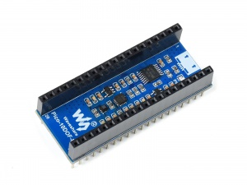
Waveshare 10 Dof IMU
Specialised for Raspberry Pi Pico
3-axis gyroscope
3-axis accelerometer
3-axis magnetometer
Barometric pressure sensor to sense atmospheric pressure of the environment
Operates at 5V
Supports an auxiliary I2C interface
$22 USD
Amazon.com: Waveshare 10-DOF IMU Sensor Module for Raspberry Pi Pico, 9-Axis Motion Sensor ICM20948 Baroceptor LPS22HB Chip Incorporate Sensors Includes Gyroscope Accelerometer Magnetometer Baroceptor : Electronics

Slide 3
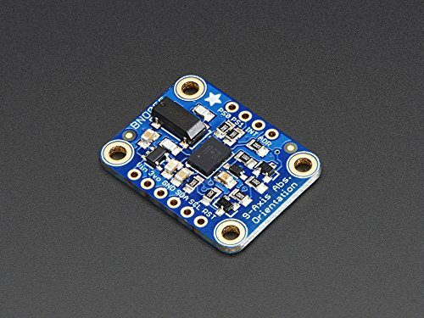
Adafruit 9-DOF Absolute Orientation IMU
Supports an auxiliary I2C interface
3-axis of rotational speed
3-axis acceleration
3-axis of magnetic field sensing
Can output sensor data in the form of quaternions
$USD 34.95
Adafruit 9-DOF Absolute Orientation IMU Fusion Breakout - BNO055 : ID 2472 : $34.95 : Adafruit Industries, Unique & fun DIY electronics and kits

Slide 4

Standard 2/2 miniature solenoid valves for fluids and inert gases
$66 USD

Slide 5
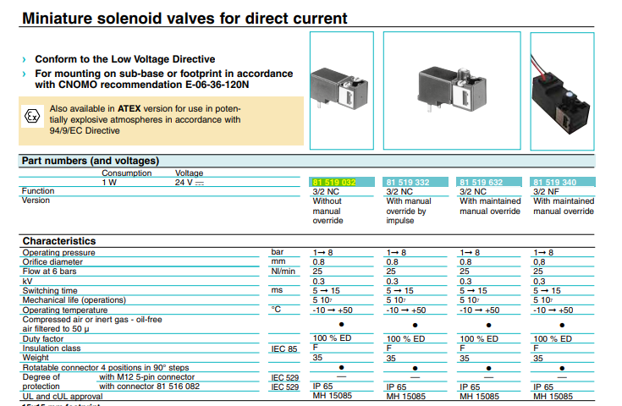
Miniature solenoid valves
$46 USD

